Slide 1

IMDB Indian Movies
Exploratory Data Analysis
IMT 562

Slide 2
About the Dataset
This Dataset contains information about Indian Movies listed on IMDB.
It contains information about 5659 Indian movies released between 1931 and 2021.
Each row of the dataset contains information about the Name of the movie, Release Year, Duration in Minutes, Genre, Rating out of 10, Votes, Director, and Top 3 Actors.
Data Source: Kaggle

Slide 3
Initial Data Assessment
My first step was to visually assess the data and perform simple manipulations like removing null values, identifying duplicates, etc.
I used R programming language (Rstudio) to do this.
While there weren’t many outliers or missing data, the column “Genre” had more than one values for some rows. I separated those values and used the resulting column.
Rest of the data points were fairly consistent.

Slide 4
Questions for EDA
Which lead actors have appeared in the most Indian movies?
Which are the most popular Genres and their average Runtimes/Durations?
Popular Directors based on Votes and Ratings?
How were movie ratings distributed between 1980-2000 and 2000-2020?

Slide 5
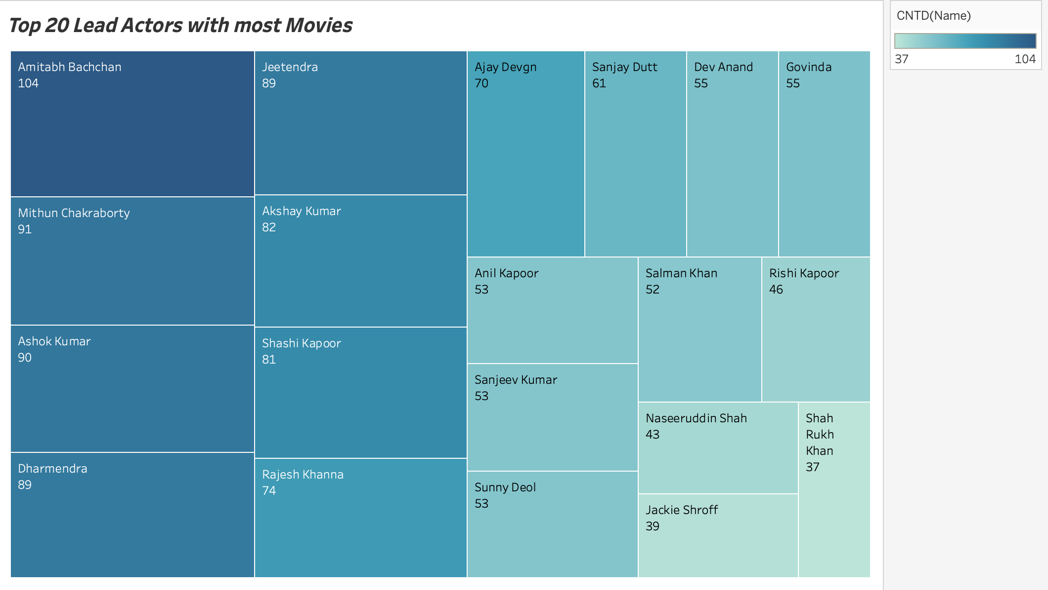
Which lead actors have appeared in the most Indian movies?
There are some lead actors in India which are immensely popular. I was curious to know the number of movies they’ve appeared in.
Interestingly, the 2 best/most popular actors are at the to and bottom of this list – Amitabh Bachchan with 104 movies and Shah Rukh Khan with 37 movies.

Slide 6
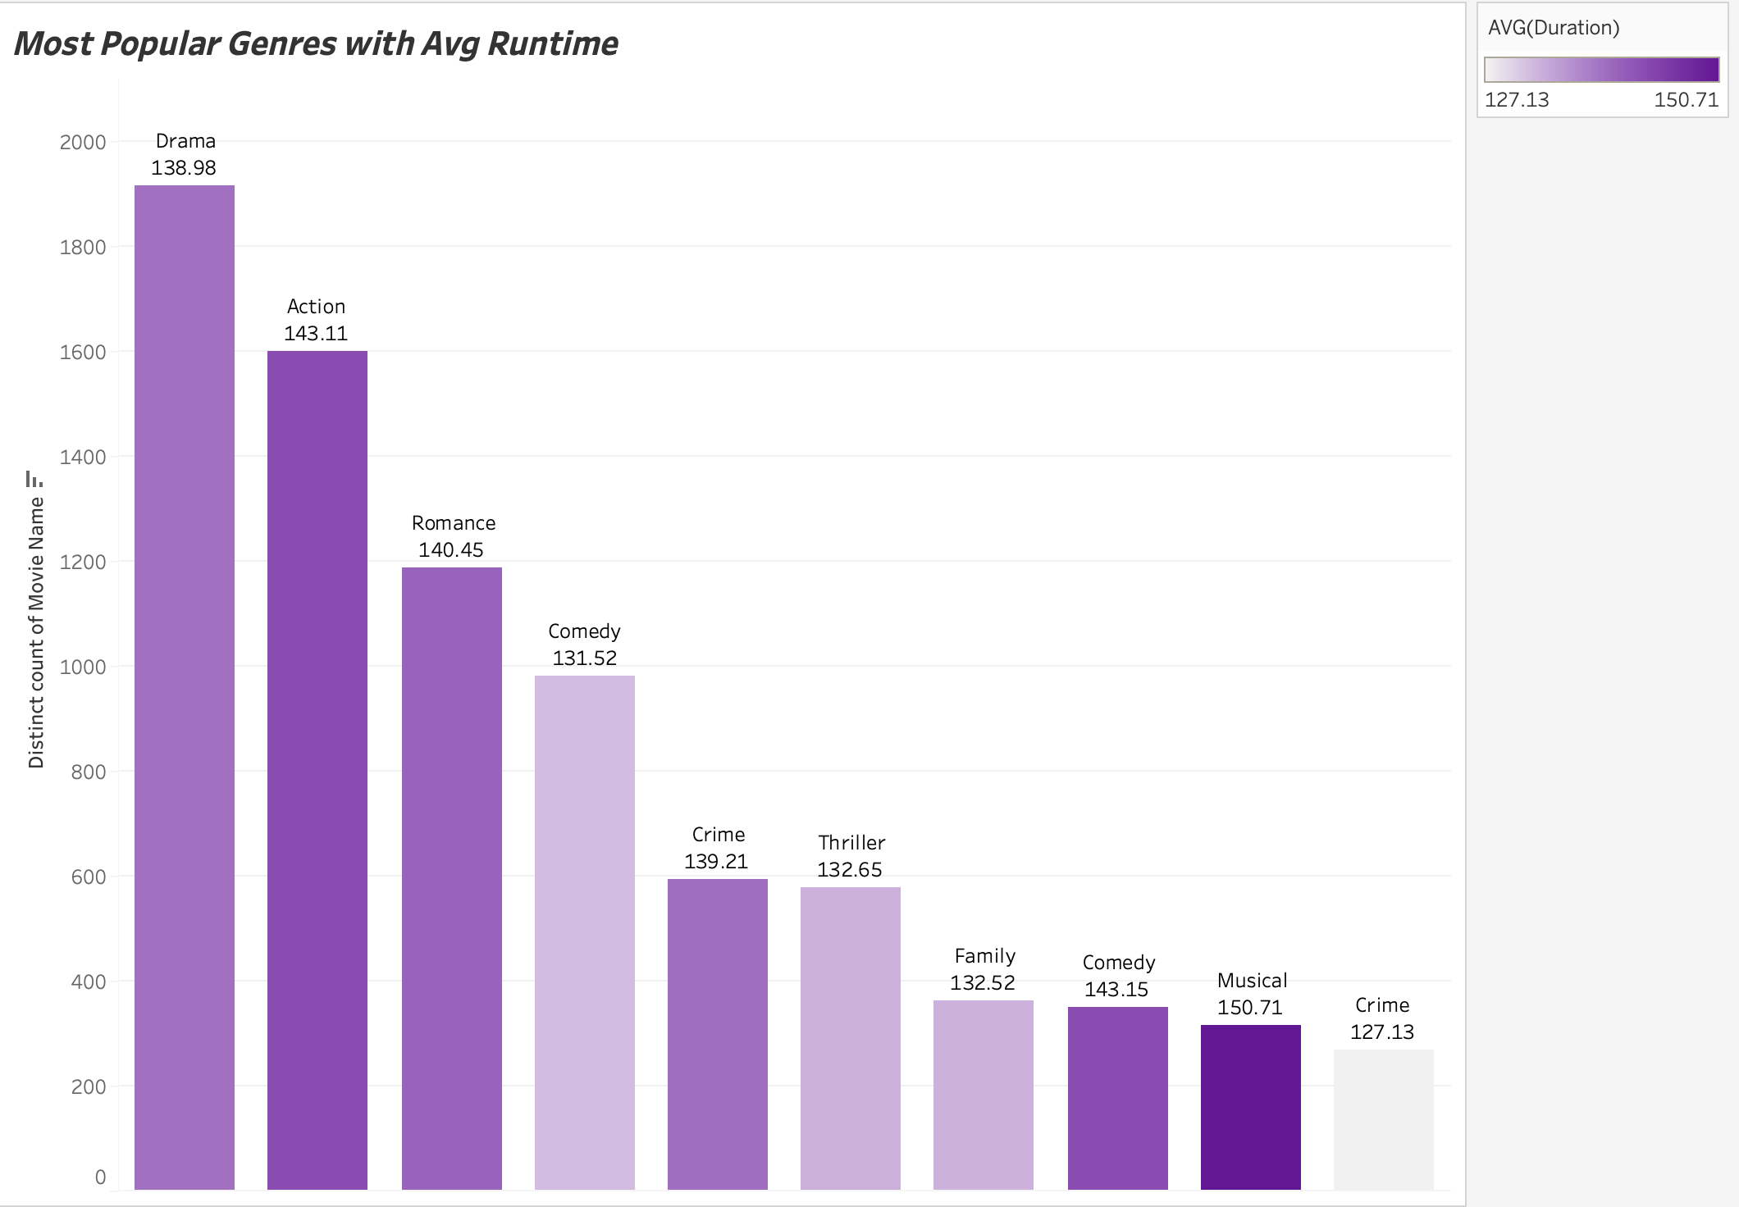
Which are the most popular Genres and their average Runtimes / Durations?
There were more than 20 genres available in Indian Movies dataset, of which, Drama is the most popular one, based on the number of movies made
The average duration of these movies is not very variant. The range is from 127 minutes to 150 minutes approximately

Slide 7
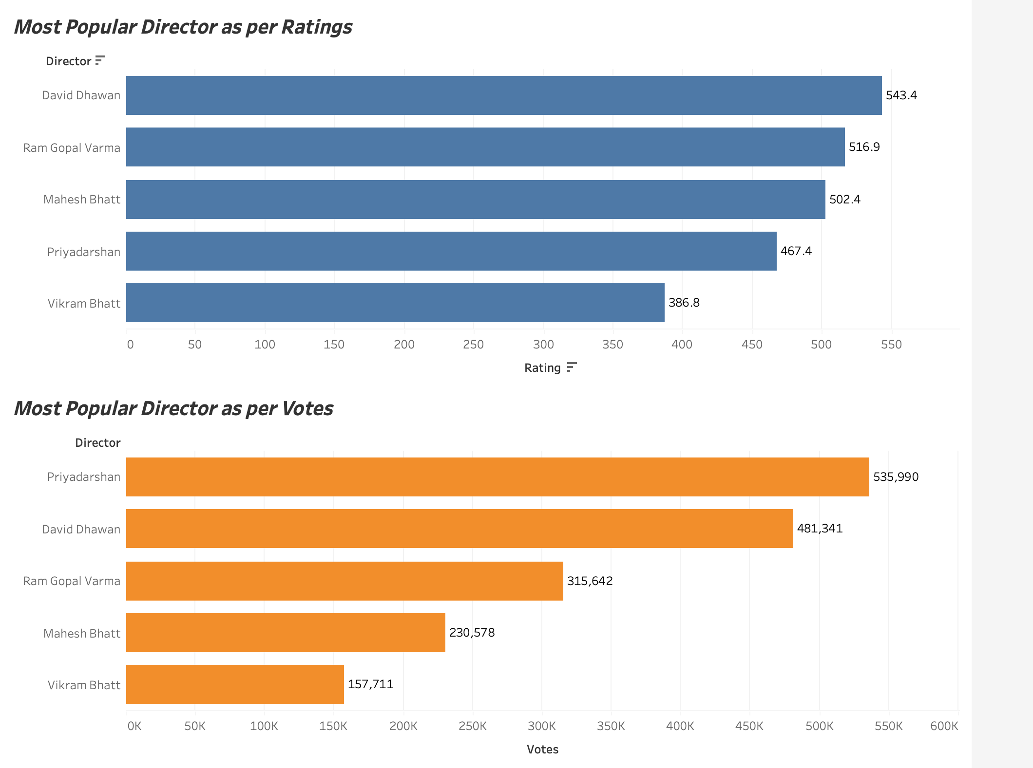
Popular Directors based on Votes and Ratings
The names of the popular directors are the same, but their ranking clearly changes when decided by Ratings v/s by Votes.
In reality as well, I have noticed that the movies appreciated by the audience are not always the most rated. This visualization confirms that.

Slide 8
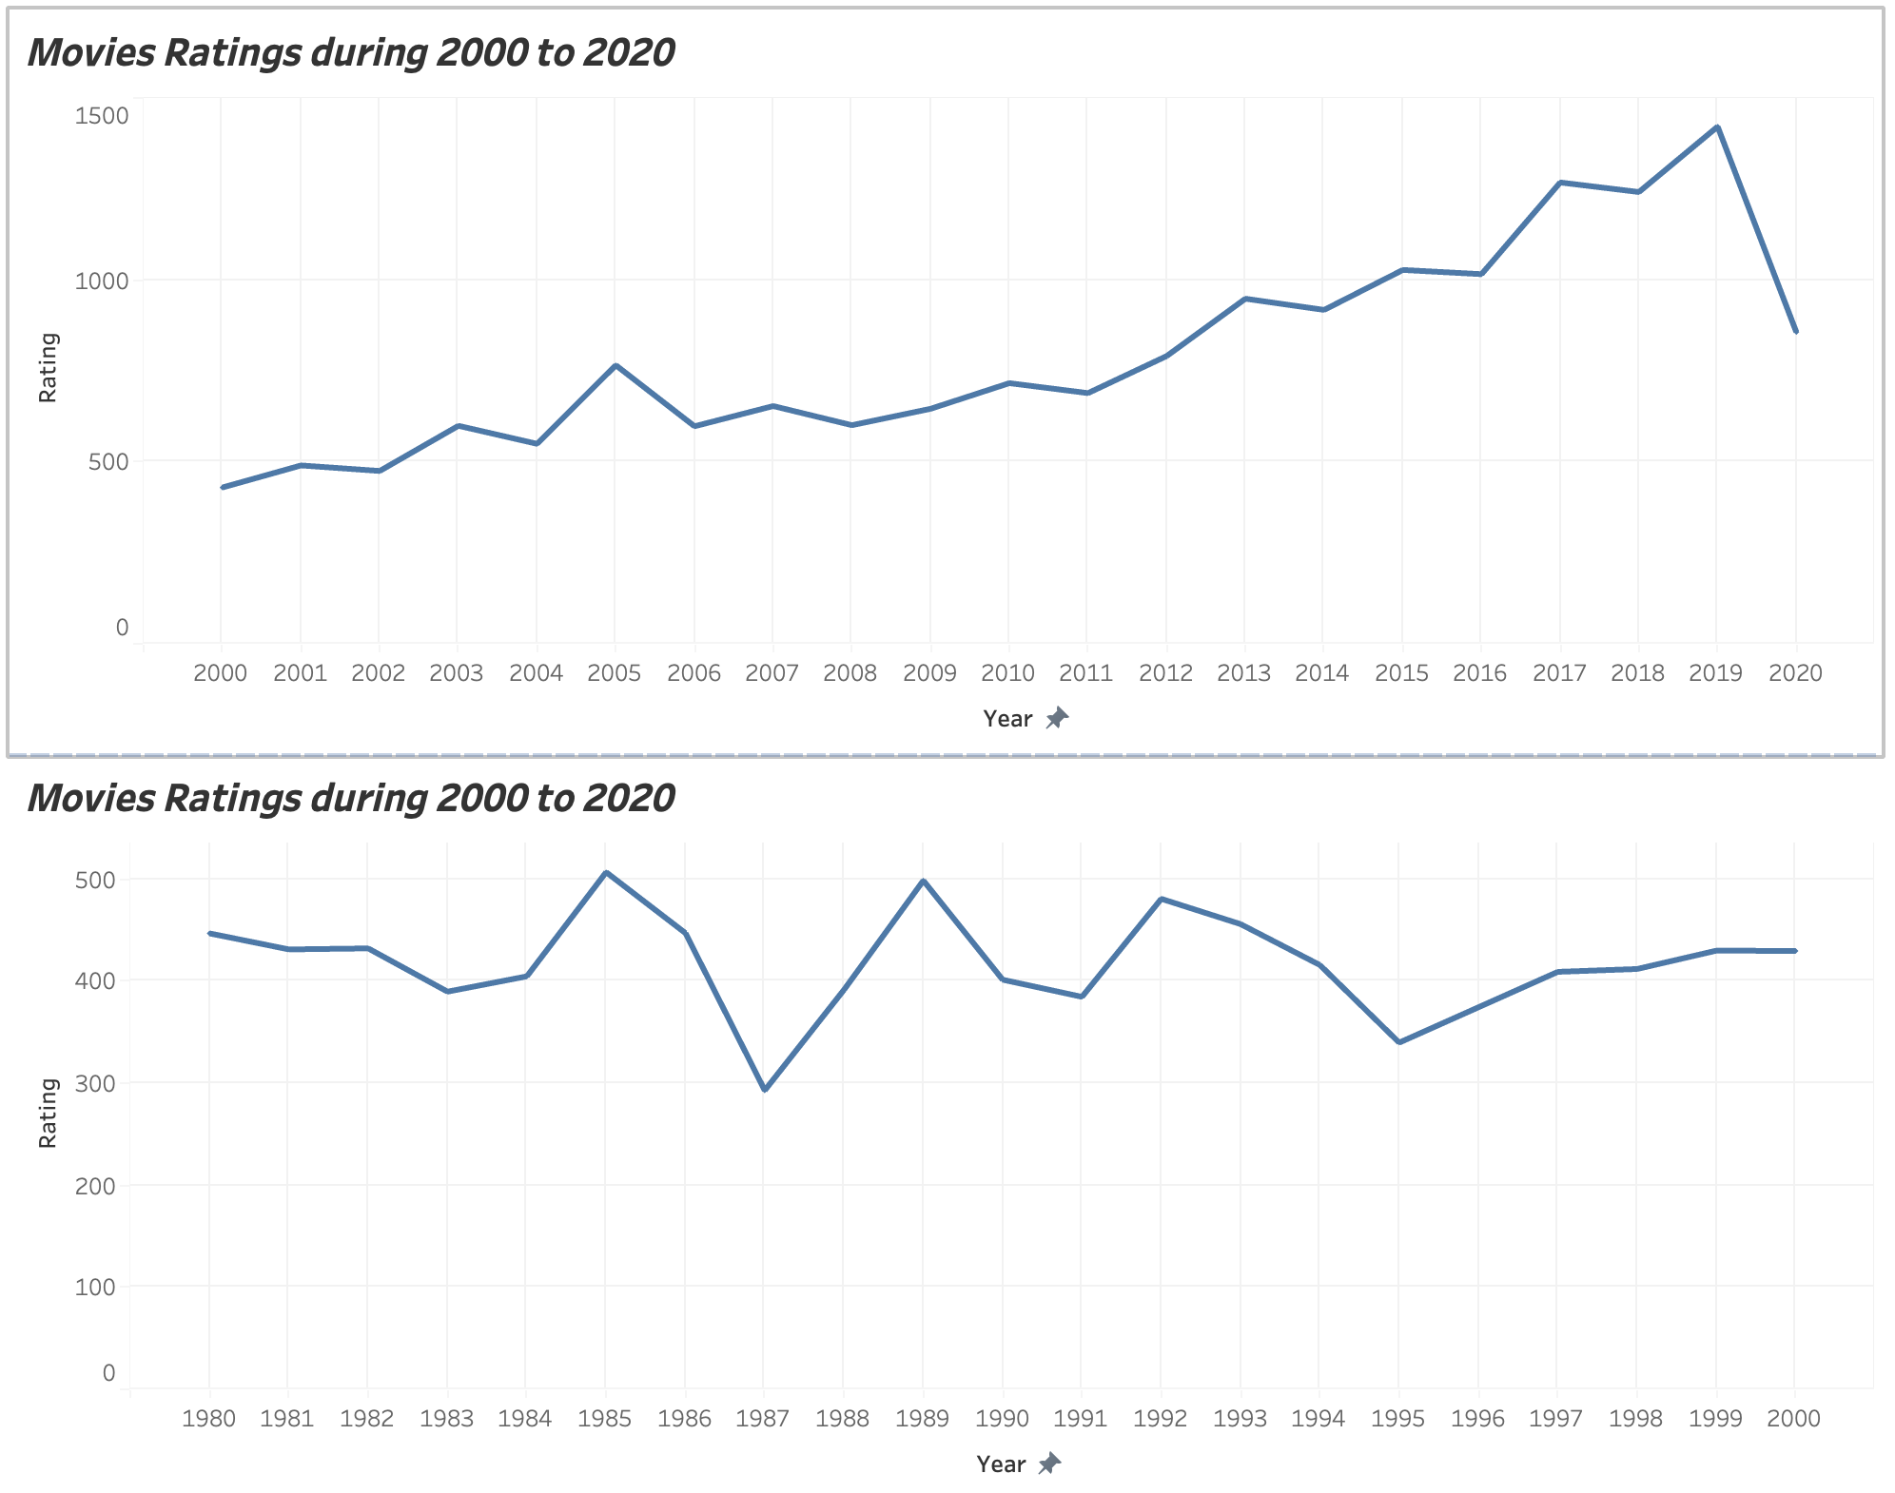
How were movie ratings distributed between 1980-2000 and 2000-2020?
I considered the first 2 decades of 2000s and the last 2 decades of 1900s and compared the movie ratings.
We can clearly see that the movies in 2000s are some of the highest rated movies of all time!

Slide 9
Key Takeaways
There are some lead actors who have appeared in a significant number of movies but are not that popular in reality
Average Runtime of Indian movies is the same generally, but there is difference in genre popularity
It looks like the 2000s have some of the best work of Indian Cinema based on Ratings.

Slide 10
Thank You!

